Slide 1
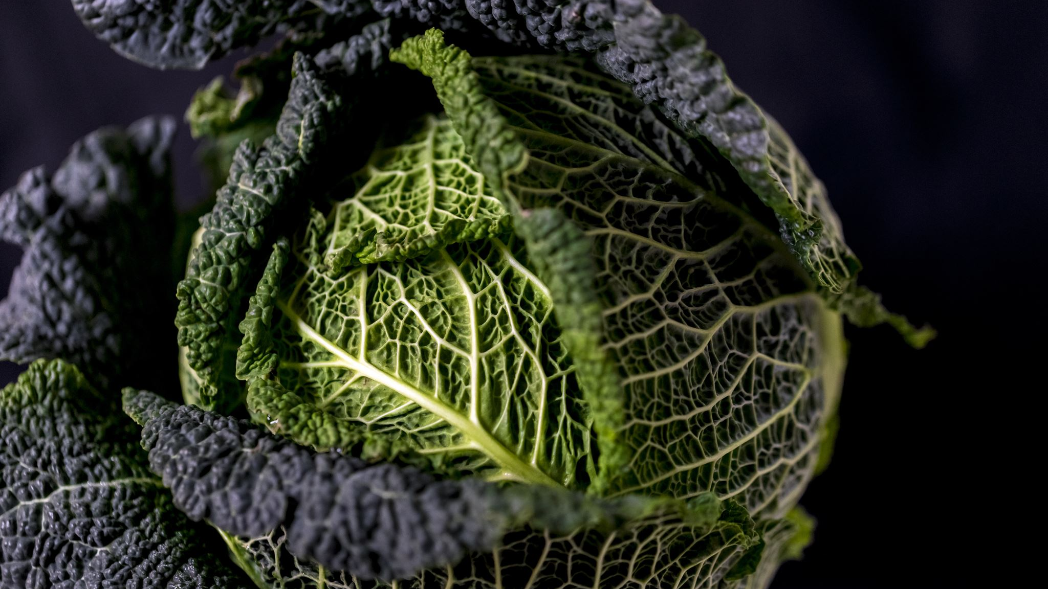
“Impact of Light Environment and Leaf-Level Shading on Photosynthetic Performance in Savoy Cabbage (Brassica oleracea)”
Master’s course – Plant chemistry
Rohith sai, Pranjel

Slide 2

Background – Light and Photosynthesis

Slide 3
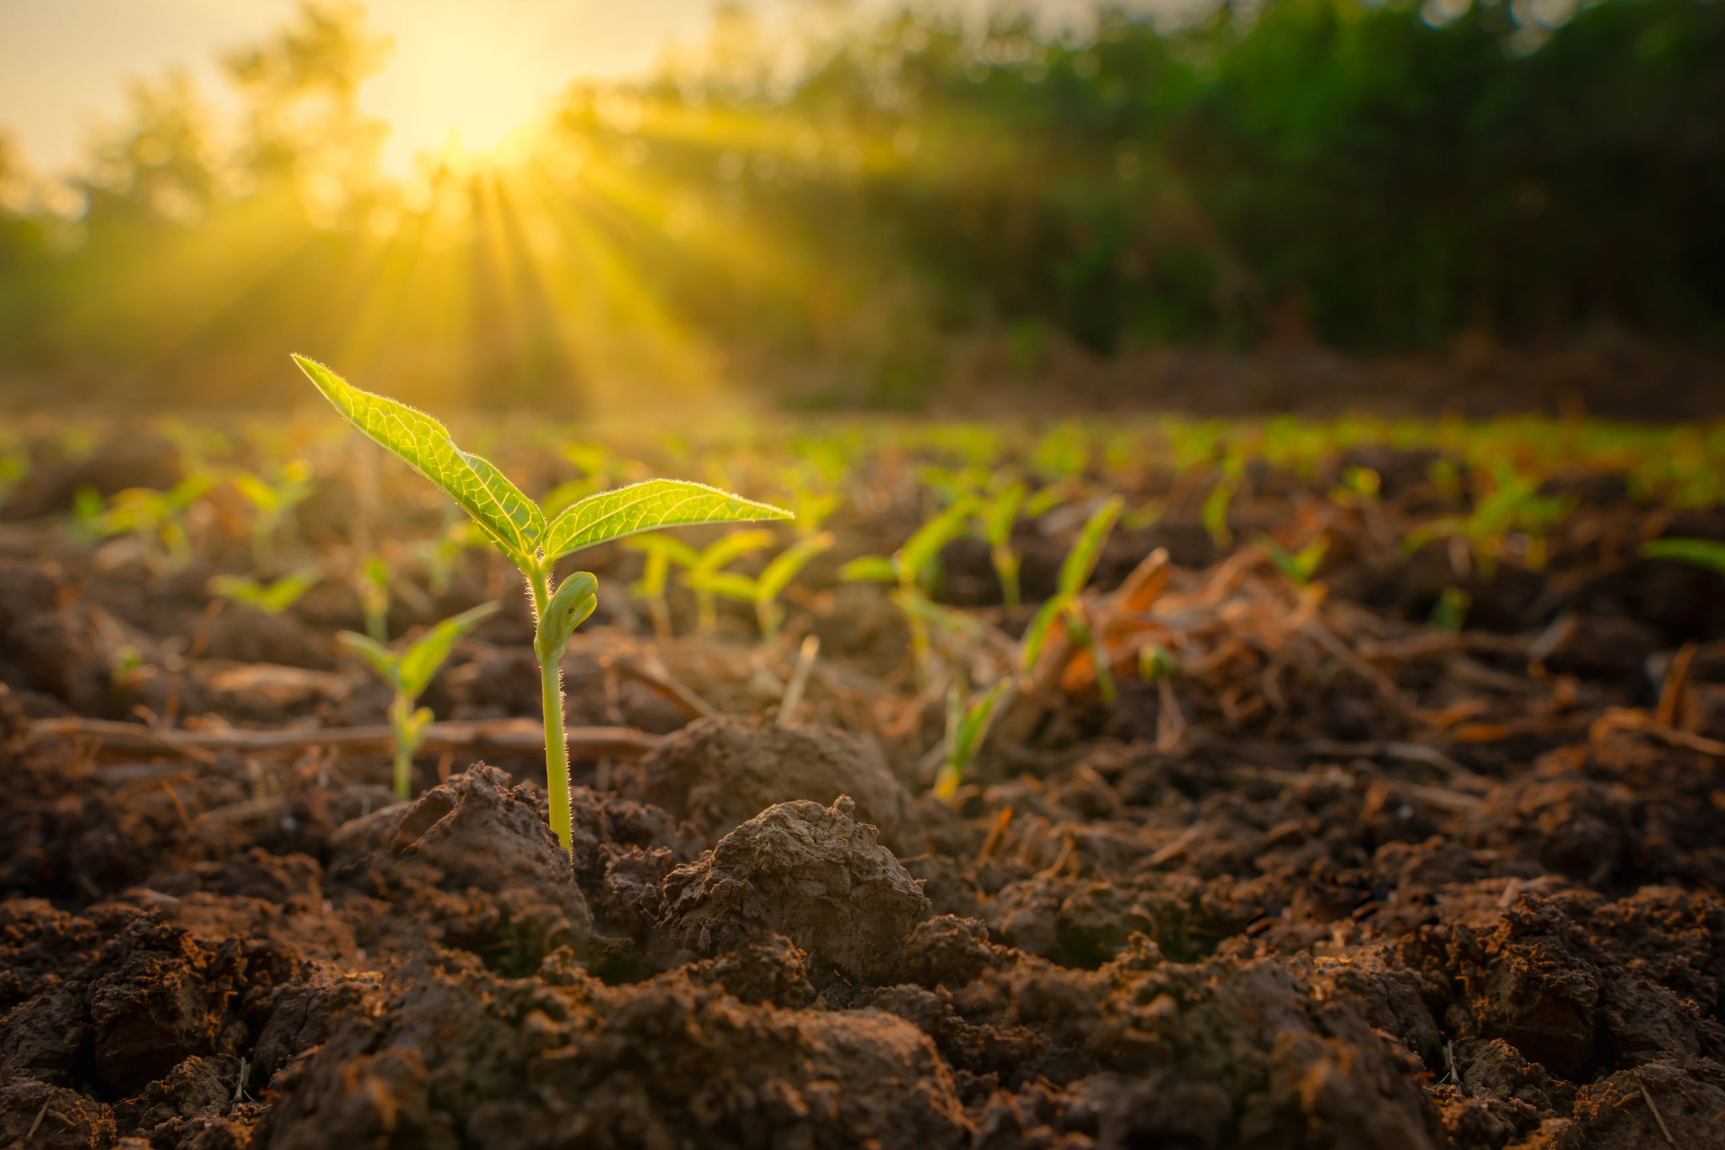


Light Stress & Photosynthesis
Why Light Can Help — and Hurt — Plants
Plants need light for photosynthesis, but too much can cause photoinhibition.
Chlorophyll fluorescence (Fv/Fm) shows how efficient a plant’s photosystem II is.

Slide 4
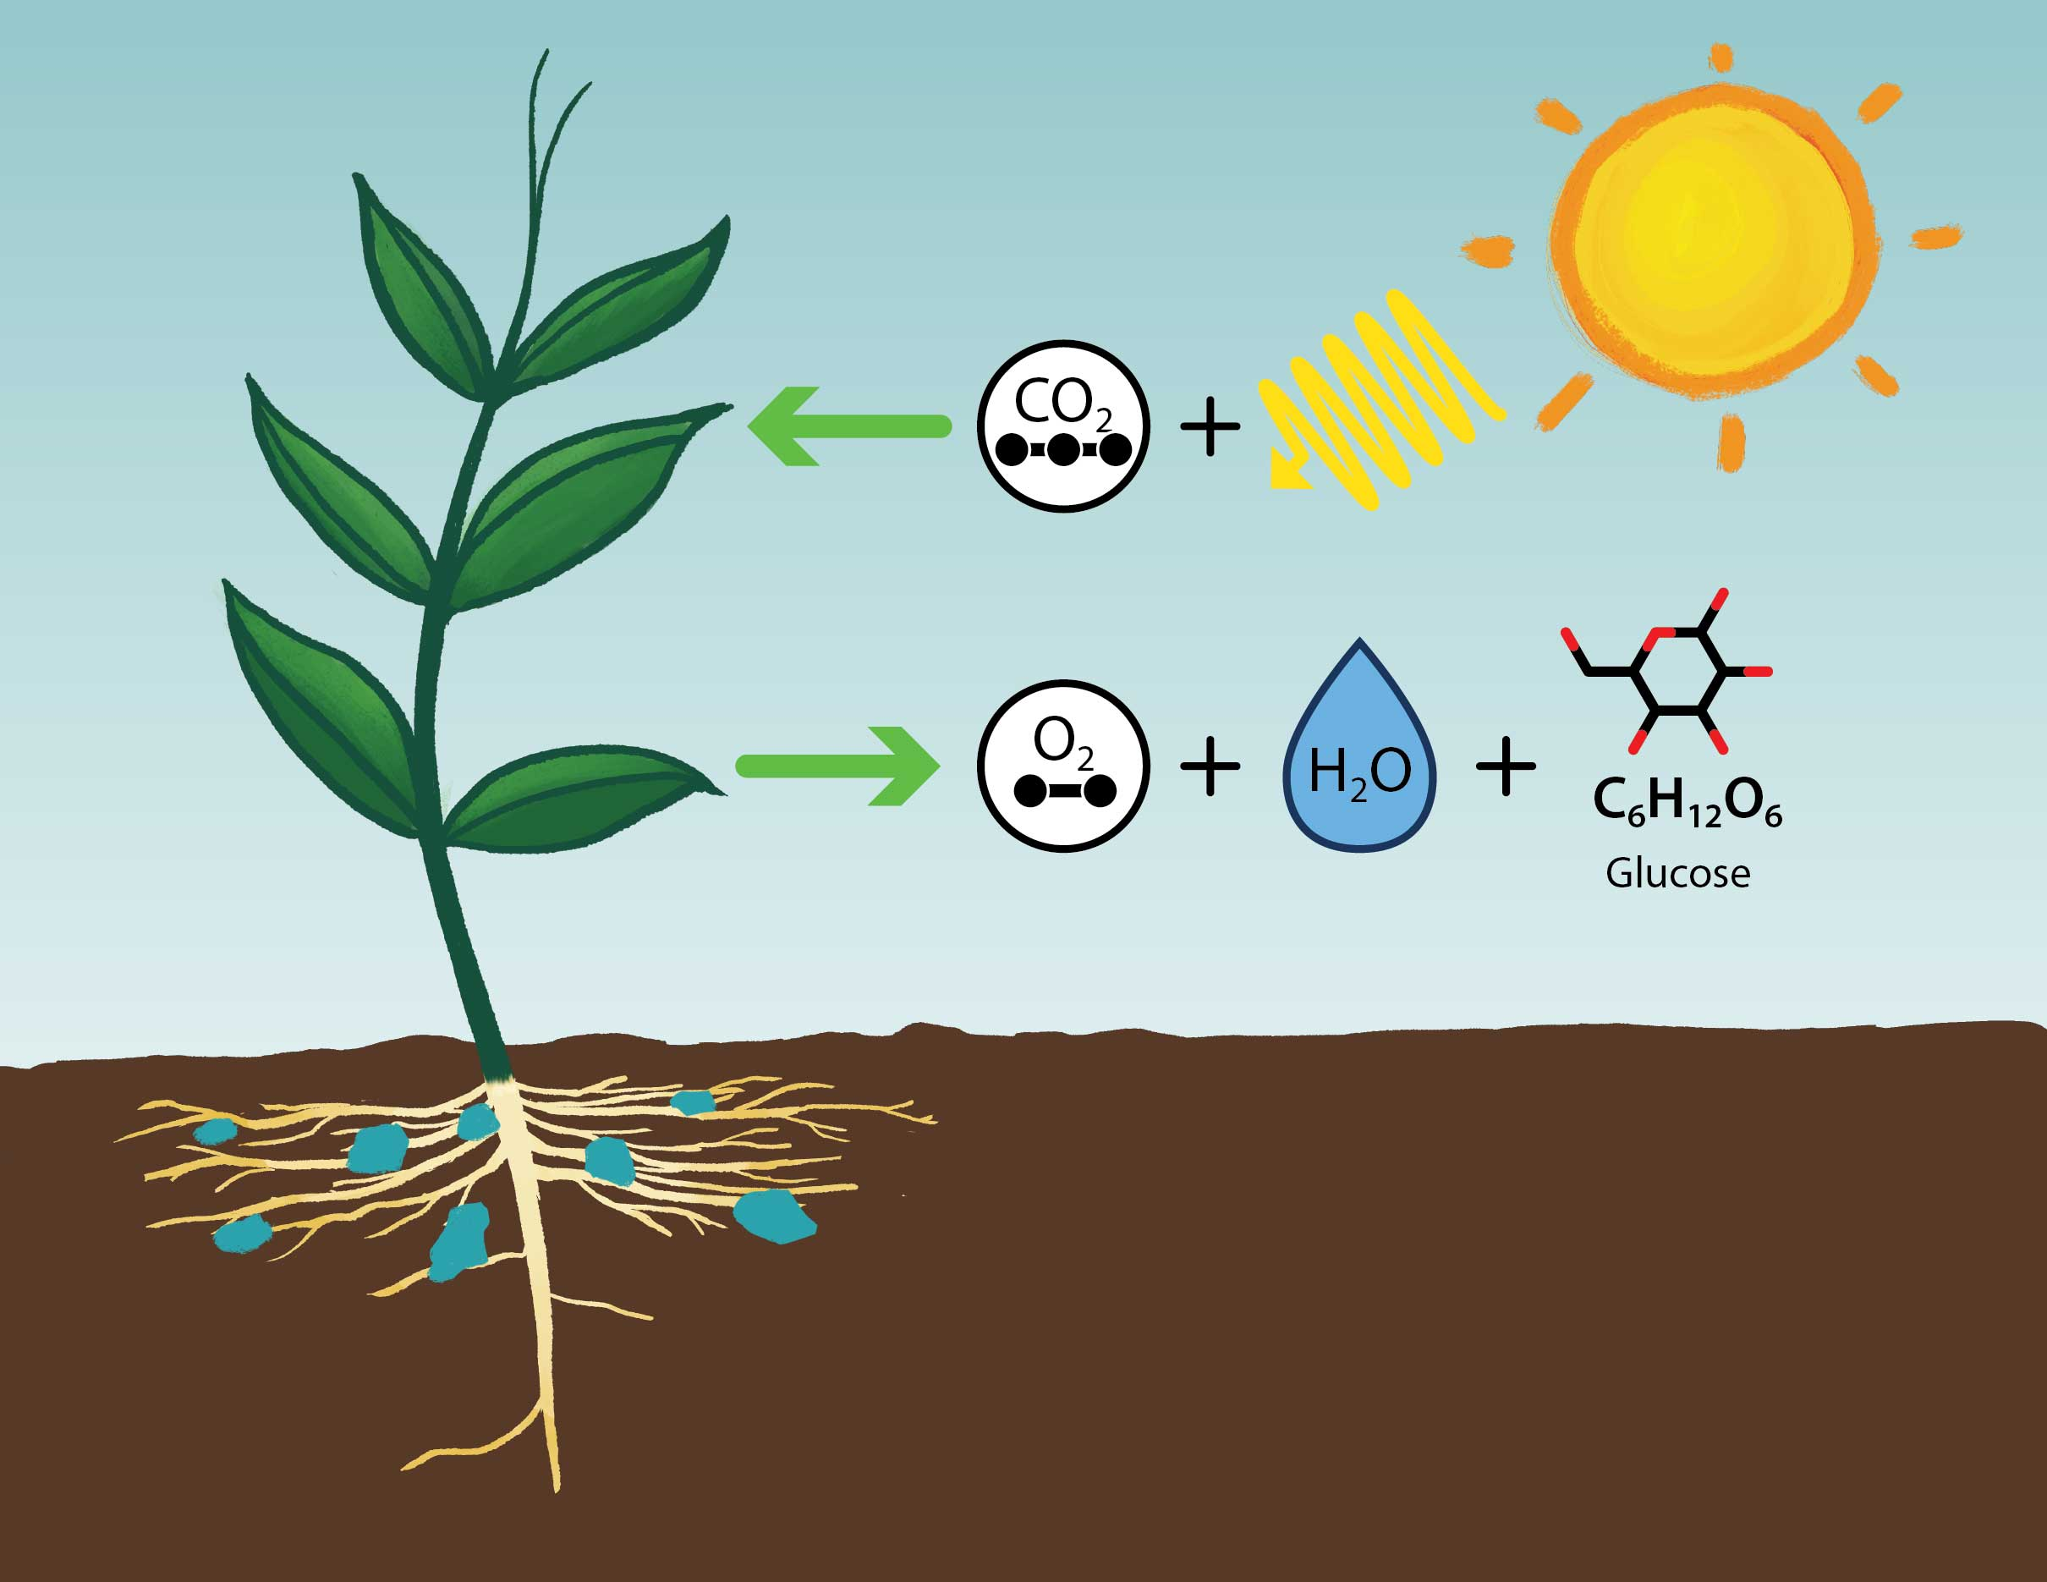
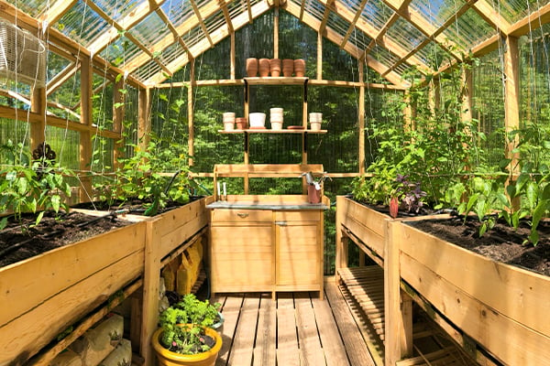
Natural sunlight has high UV → risk of light stress
Greenhouse light is filtered → lower stress, less UV

Slide 5
Light Exclusion & Leaf Adaptation
What Happens When a Leaf Is Shaded?
Short-term shading (like bagging) reduces light exposure.
Bagged leaves are dark-adapted → recover efficiency
This helps reveal the maximum potential of photosynthesis.
Rarely studied in combination with natural vs. controlled light environments

Slide 6
Literature Gap
Studies mostly focus on drought, heat, or whole-plant shading
01
Leaf-level light stress + short-term shading = underexplored
02
Few compare greenhouse vs. outdoor light at this scale
03
No clear understanding of how quickly leaves recover under bagging
04

Slide 7
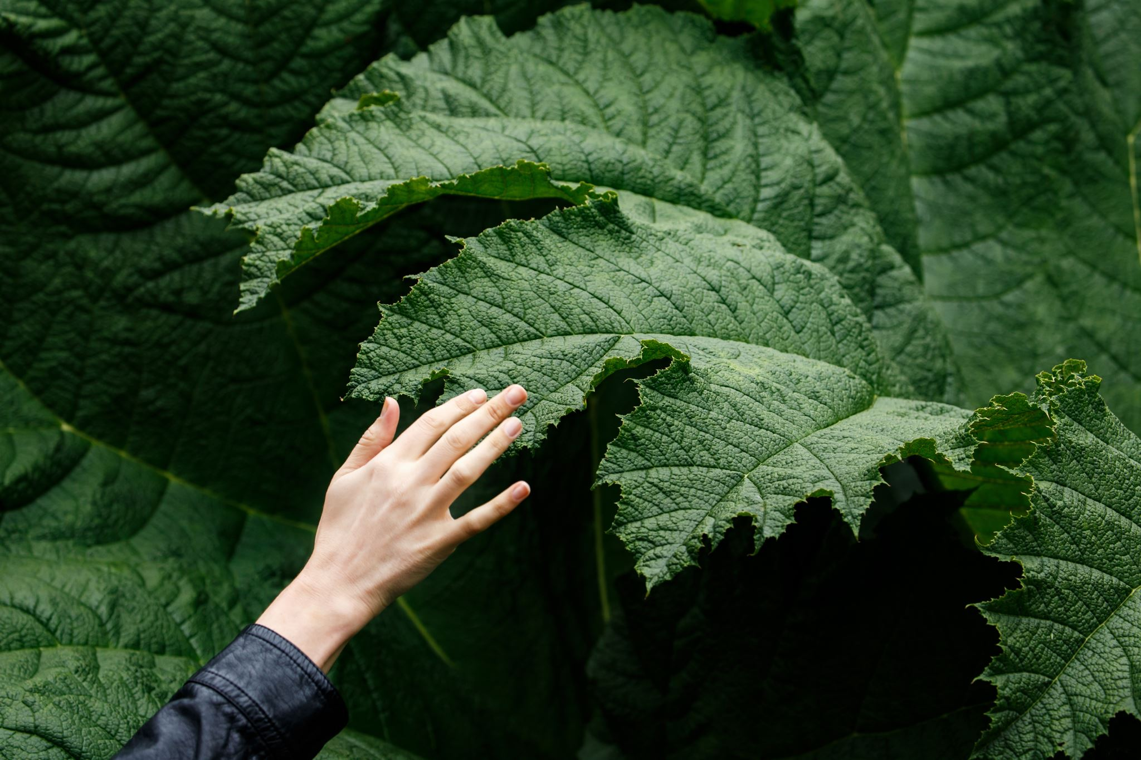
Research Question:
How do environmental light conditions (greenhouse vs. outdoor) and short-term leaf shading (bagging) affect photosynthetic efficiency and gas exchange in Savoy cabbage leaves?

Slide 8

Hypothesis:
Leaves exposed to intense natural sunlight (outside, unbagged) will exhibit reduced photosynthetic efficiency due to photoinhibition, while bagged leaves and those grown under greenhouse conditions will show higher efficiency as a result of reduced light stress and increased photochemical stability.

Slide 9
Experimental Setup
Species: Savoy cabbage (Brassica oleracea)
Total Plants: 10 → 5 in natural sunlight (outside) → 5 in filtered light (greenhouse)
Per Plant Setup: → 1 unbagged leaf (normal light) → 1 bagged leaf (covered with white paper bag)
 | GREENHOUSE | OUTSIDE
BAGGED | 5 | 5
UNBAGGED | 5 | 5

Slide 10


Experimental Timeline
Measurement Schedule (30 May – 4 June 2025)
DATE | DARK YIELD | LIGHT YIELD | PAM | GAS EXCHANGE
JUNE 2
JUNE 3
JUNE 4
Gas exchange: Measured using GAS 3000 on Day 3 & Day 5
PAM fluorescence: Fv/Fm (dark yield), light yield, and PAM every day
Consistent sampling: Same leaves monitored throughout

Slide 11
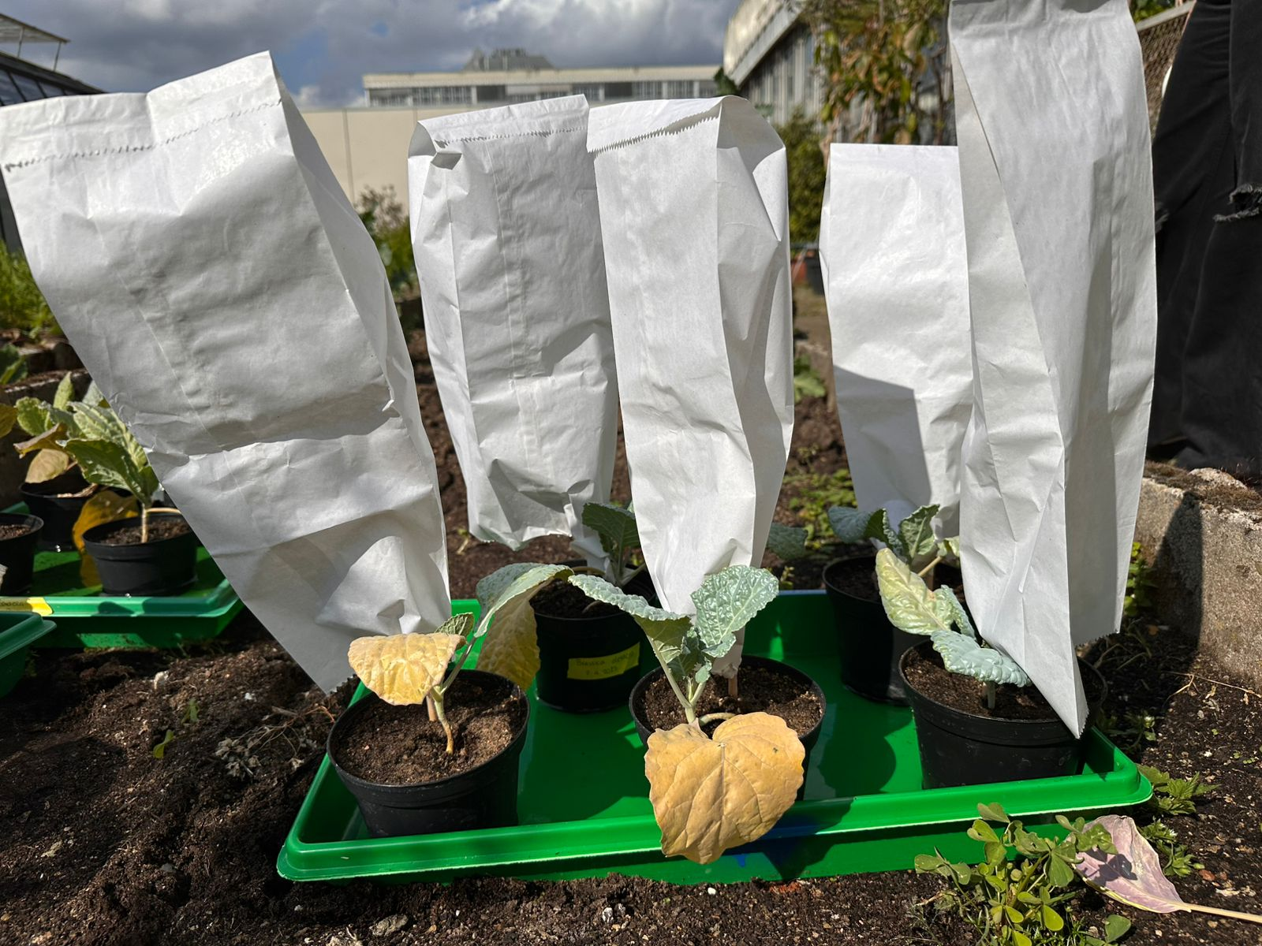
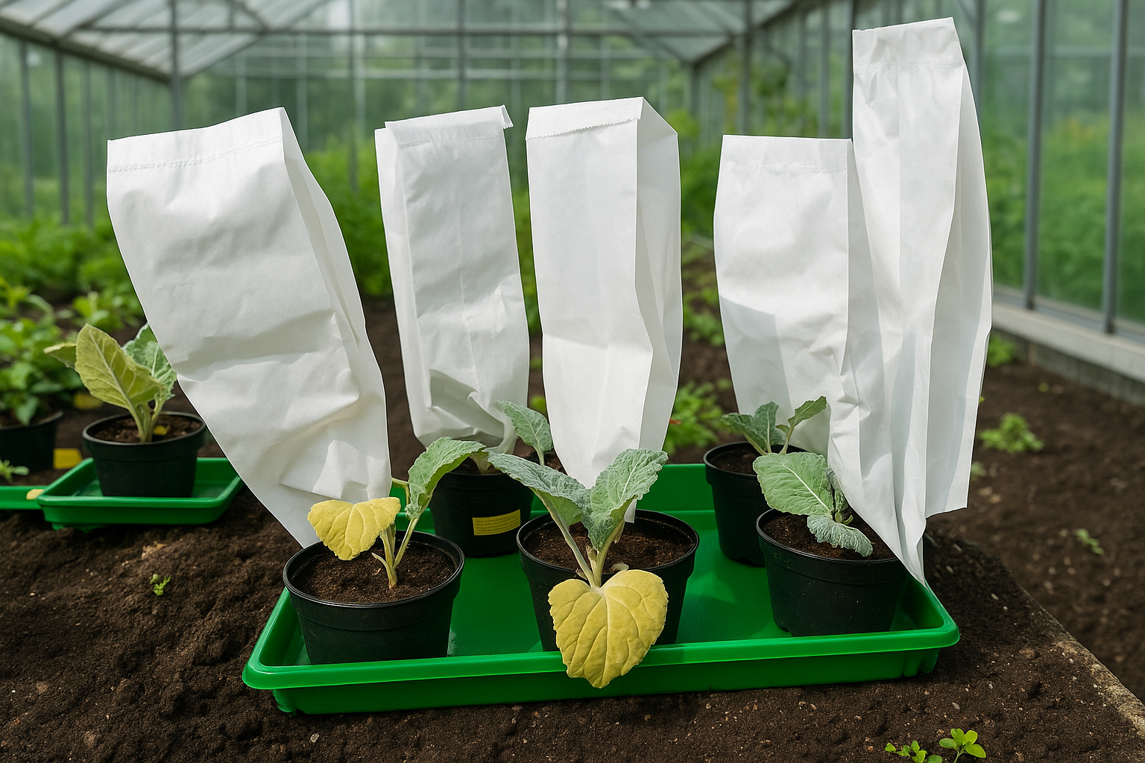
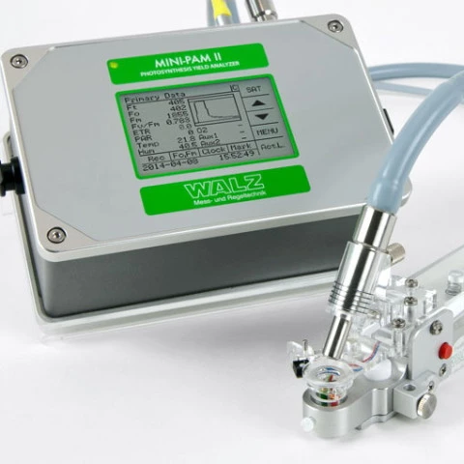
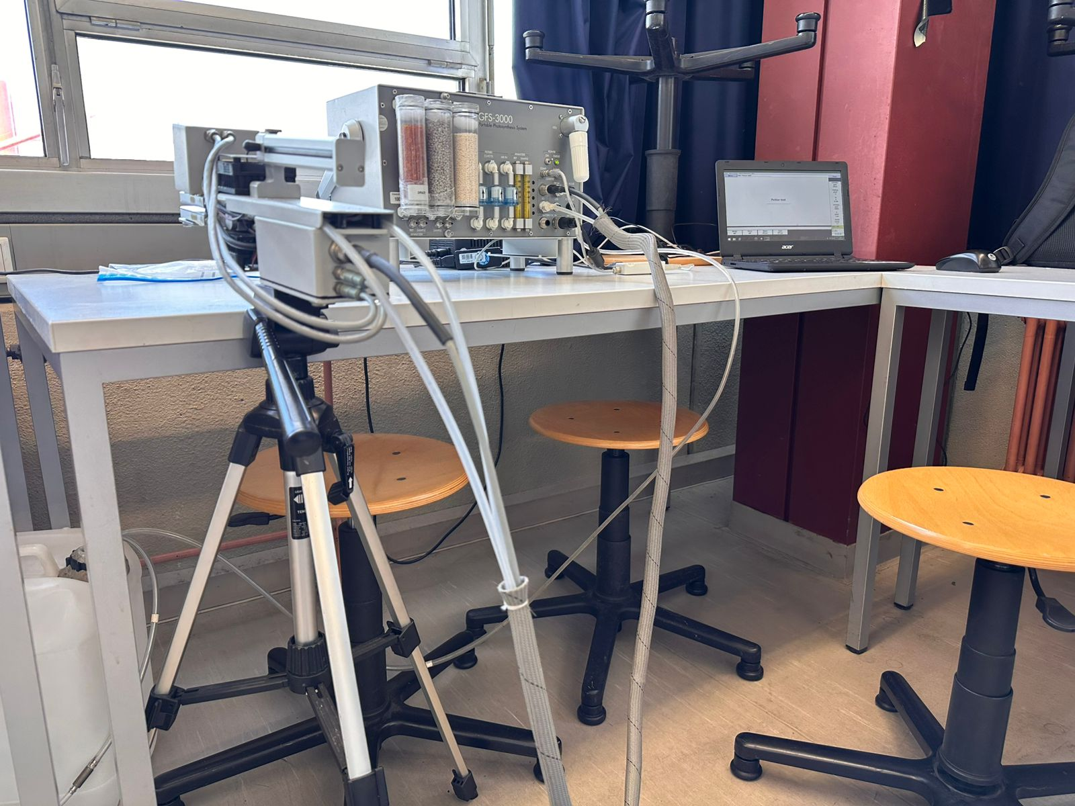
Outside - UV
Greenhouse - control
PAM fluorimeter (Dark and light yield)
GFS–3000 portable photosynthesis system

Slide 12
Measurement Parameters & Devices
Parameter | Explanation | Instrument
Dark Yield (Fv/Fm) | Maximum PS II efficiency (dark-adapted) | PAM Fluorometer
Light Yield | Efficiency under actinic light | PAM Fluorometer
PAM Value | Yield at constant actinic light | PAM Fluorometer
A (CO₂ Uptake) | Photosynthetic rate | GAS 3000 Portable Photosynthesis System
E (H₂O Loss) | Transpiration rate | GAS 3000 Portable Photosynthesis System

Slide 13
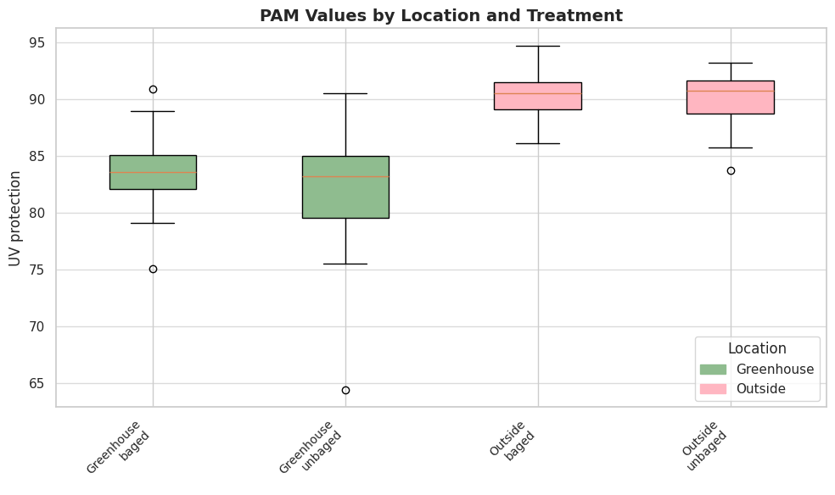
Results: PAM values by location and Treatment
Stronger physiological response to sunlight
Greenhouse unbagged, → inconsistent UV exposure, or protection mechanisms
N=5

Slide 14
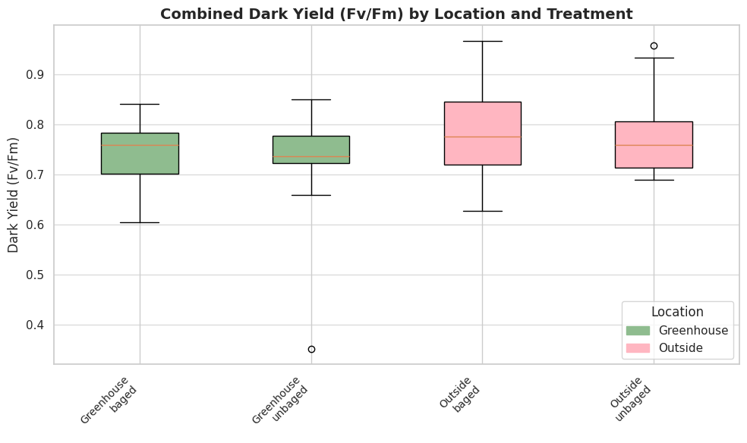
Dark Yield (Fv/Fm) by location and treatment
Outside-bagged → highest, suggesting healthier PS II systems
Greenhouse unbagged → indicating higher stress or damage to PS II
N= 5

Slide 15
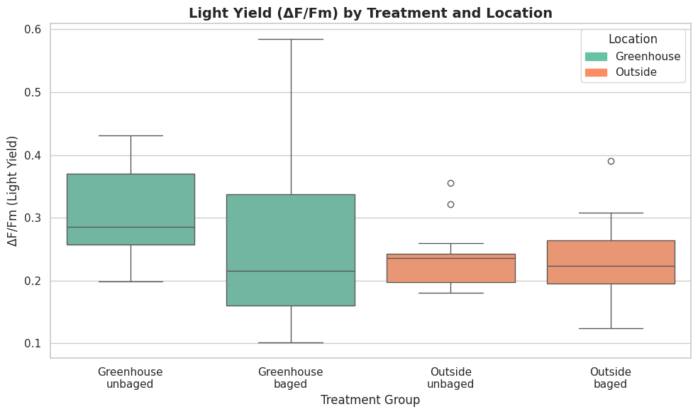
Light yield (ΔF/Fm) by treatment and location
Greenhouse-unbagged plants best under light → higher photosynthetic yield
Both outside → lower light yield, possibly due to UV stress or stomatal limitations
N=5

Slide 16
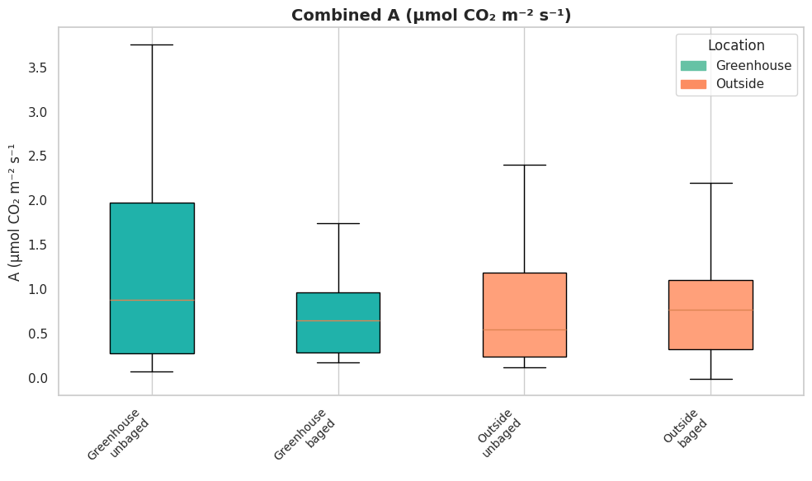
Effects of location and bagging on photosynthetic rate
Outside bagged → -0.01
N=5

Slide 17
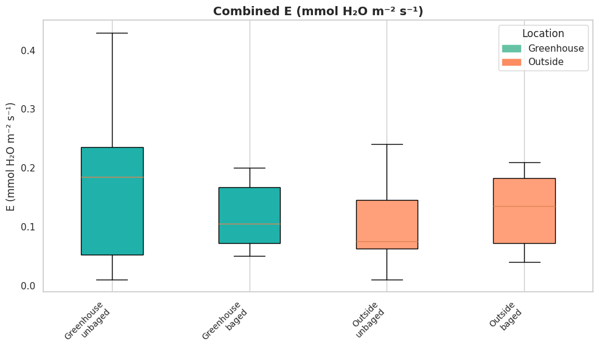
Effects of location and bagging on Transpiration Rate
Outside → ↓compared to the greenhouse conditions overall
N=5

Slide 18


SUMMARY TABLE
PARAMETER | OUTSIDE UNBAGGED | OUTSIDE BAGGED | GREENHOUSE UNBAGGED | GREENHOUSE BAGGED
DARK YIELD | L | M | M | H
LIGHT YIELD | L | M | M | H
PAM VALUE | L | M | M | H
CO2 RATE | V | L | H | M
TRANSPIRATION | H | M | M | M

Slide 19
Discussion:
UV protection → ↑ in outdoor plants, suggesting enhanced synthesis of UV protective compounds.
Dark yield → outside bagged, indicating better PS II recovery.
Light yields → ↑ greenhouse unbagged better efficiency under light.
Greenhouse unbagged → ↑ photosynthetic & transpiration rates, indicating optimal gas exchange.
Outside conditions led ↓ A &E overall, possibly due to environmental stress.

Slide 20
Conclusion:
Outdoor conditions boost UV defense and PS II potential.
Greenhouse conditions favor higher light-phase photosynthetic performance.
Treatment & environment interaction significantly affect photosynthetic function.
Greenhouse unbagged is the most favorable condition for gas exchange

Slide 21
DISCUSSION
Bagged leaves consistently showed higher dark/light yield and PAM → indicates photoinhibition recovery under reduced light.
Greenhouse plants had better overall performance than outdoor → suggests filtered light reduces environmental stress.
CO₂ assimilation was highest in greenhouse unbagged leaves → supports the idea that moderate light boosts photosynthesis.
Transpiration was highest in outdoor unbagged leaves → indicates increased stomatal activity and water loss under high light/UV.
No strong interaction effects → suggests that bagging and location act independently, not synergistically.

Slide 22
Discussion of hypothesis:
Leaves exposed to intense natural sunlight (outside, unbagged) will exhibit reduced photosynthetic efficiency due to photoinhibition, while bagged leaves and those grown under greenhouse conditions will show higher efficiency as a result of reduced light stress and increased photochemical stability.
Partially supported hypothesis
Notes:
Outdoor unbagged leaves experienced photoinhibition, but bagging did not enhance photosynthetic efficiency.

Slide 23
Methodology → Limitations :
A smaller number of plants per treatment
No- Statistical test performed
Short-term measurement
Biomass
Lack of long-term measurements

Slide 24

Any Questions and comments

